Slide 1
nttsecurity.com
Hands on Hardened
Web Service Development
Using ASP.NET
Notes:
© 2017 NTT Security

Slide 2
Disclaimer
The opinions expressed in this presentation and training class are solely those of the presenter and not necessarily those of NTT Security or OWASP.

Slide 3
IDE Basics
Visual Studio 2017 15.3
Hello World
Building & Debugging

Slide 4
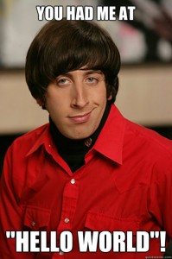
Hello World
using System; using System.Collections.Generic; using System.Linq; using System.Text; using System.Threading.Tasks; namespace Hello_World { class Program { static void Main(string[] args) { string Hello = "Hello World"; Console.WriteLine(Hello); } } }

Slide 5
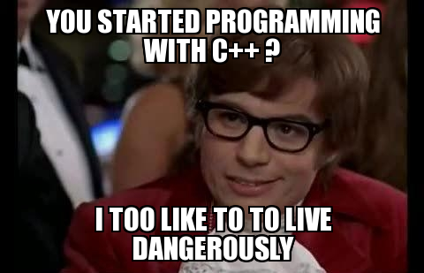
Basics of Object Oriented Programming
Objects
Classes
Abstractions
Encapsulation
Inheritance
Polymorphism
Overloading

Slide 6
Objects
Basis of object oriented programming
Everything in .NET managed code can be considered an object.
Objects also specifically reference an instance of a class

Slide 7
Classes
Provides common place for similar code
Provides built-in security in form of ‘private’ and ‘protected’
Aids in returning and receiving complex types from services
Security starts at the foundation

Slide 8
Abstraction
Abstraction is a process where you show only “relevant” data and “hide” unnecessary details of an object from the user.
Sort of like an interface, but not
Abstract classes commonly used in design patterns
Think SDK’s for your services

Slide 9
Encapsulation
A wrapper around something
Encapsulation is the process of combining data and functions into a single unit called class. In Encapsulation, the data is not accessed directly; it is accessed through the functions present inside the class. In simpler words, attributes of the class are kept private and public getter and setter methods are provided to manipulate these attributes. Thus, encapsulation makes the concept of data hiding possible.

Slide 10
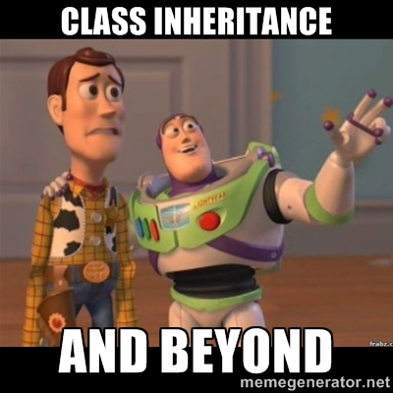
Inheritance
Allows several objects to be created from a single “template”
Classes can inherit other classes, or interfaces
You see this with WCF predominately

Slide 11
Polymorphism
True “Templating”
Conditional’s based on object type
Not directly feasible in the “presentation” of a web service

Slide 12
Overloading
Allows a single method to accept different parameter sets
Allows overloading of methods in parent classes
Combines well with abstraction and inheritance

Slide 13
3rd Party Libraries
JSON.NET (Newtonsoft.Json)
PushSharp
BouncyCastle
AntiXSS

Slide 14
JSON.NET
Good for Deserializing and Serializing Objects for JSON
Override default serializer for MVC/Web API
Useful utilities for making JSON calls inside of the service itself
https://www.newtonsoft.com/json

Slide 15
PushSharp
Library for sending notifications to mobile devices
Since many mobile apps utilize web services, could be useful in OS integrations
Utilizes JSON to form messages for notifications
Easy to combine with JSON.NET
https://github.com/Redth/PushSharp

Slide 16
BouncyCastle
Standardized encryption library
Library has Java version
Can possibly ensure interoperability between .NET and Java based systems
https://www.bouncycastle.org/

Slide 17
AntiXSS
Used specifically for input/output encoding
For non Web API applications (WCF, MVC, WebForms)
Prior to .net 4.5 https://www.nuget.org/packages/AntiXSS/

Slide 18
WCF Service Bindings
Service bindings determine security
Service bindings determine connection types for specific endpoints
http://www.c-sharpcorner.com/uploadfile/pjthesedays/wcf-service-binding-explained/

Slide 19
Binding Parameters
Behaviors
Contracts
Security

Slide 20
Behaviors
Endpoint Behavior
Service Behavior

Slide 21
Contracts
Each WCF Service needs a contract (an interface)
This specifies methods to be included in the service

Slide 22
Security
Specify transport level security
Specify message level security

Slide 23
Database Design
ADO.NET
Entity Framework
Parameterized queries & Stored Procedures
Performance
Sample Database ☺

Slide 24
SOAP Services
Not accessible via traditional GET/POST
Strongly typed definitions
Uses XML for communication
WS-Basic & WS-Security Specifications available
Can be easier to develop clients for
WSDL IS the SDK in some instances

Slide 25
RESTful Services
Three flavors
WebMethods (EWWWW)
WCF webHttpBinding (Easy)
Web API (Moderately difficult)
By default, no security whatsoever
Both offer some challenges

Slide 26
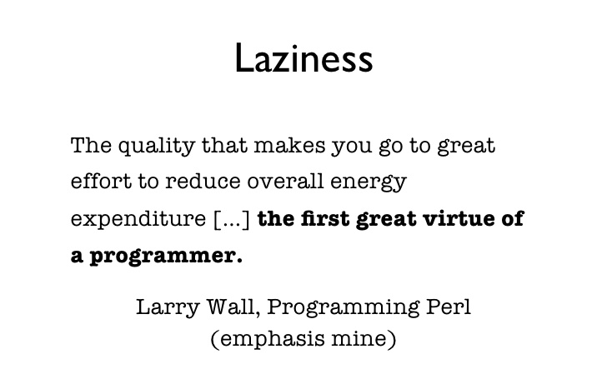

Slide 27
Response Encapsulation
Provide a small degree of security
Provides a great deal of control over responses to service users
Can simplify service writing by having one common return type for the services

Slide 28
Input Validation
Do you trust all client input?
Do you store unstrusted input?
Encoding input/output
Canonicalization
Stripping untrusted character sets

Slide 29
XXE, SQLi, and XSS
Only one of these directly affects a .NET service
Injection based attacks

Slide 30
XSS
Cross Site Scripting
Not directly a service problem
Service security should also mitigate this by encoding output. Why? Why not?
https://www.owasp.org/index.php/XSS_(Cross_Site_Scripting)_Prevention_Cheat_Sheet

Slide 31
XXE
External Entity Injection
By default, cannot occur in .NET. (.NET 4.5.2+)
https://www.owasp.org/index.php/XML_External_Entity_(XXE)_Prevention_Cheat_Sheet

Slide 32
SQLi
SQL Injection – the bane of a programmer
Avoid “TEXT” commands
Avoid combining user input with entity sql
Use parameterized queries or parameterized stored procedures
https://docs.microsoft.com/en-us/dotnet/framework/data/adonet/ef/security-considerations

Slide 33
SSL
Again comes in two flavors
Transport layer security (https vs http)
SSL Certs for identification
Avoid weak ciphers
Avoid SSLv2, SSLv3, TLS 1.0

Slide 34
Credential Types
Certificate
Username
Windows
Token

Slide 35
Encryption
Utilize SSL for transport encryption
Encrypt sensitive message data
Encrypt web.config if possible

Slide 36
Certificates
Certificates can serve as user auth
Certificates can serve as device auth

Slide 37
Replay Attacks
Man-In-The-Middle precursor
Reply intercepted to target (modified data)
Mitigate with nonce, timestamps, etc.
.NET based client by default, attempt to mitigate against this if you use SSL.

Slide 38
Cross Site Request Forgery
For services, can also be known as “Server-Side Request Forgery”
Client example
Mitigate if needed

Slide 39
WS-Security
Web Service Specification
Designed to address issues, using already existing technology
SOAP headers contain security information
Mitigates replay attacks
Allows use of both identities and roles

Slide 40
Signature Based
Commonly called HMAC Authentication
Amazon S3
Example in WCF
Could not get this to work in the new .NET Core 2.0

Slide 41
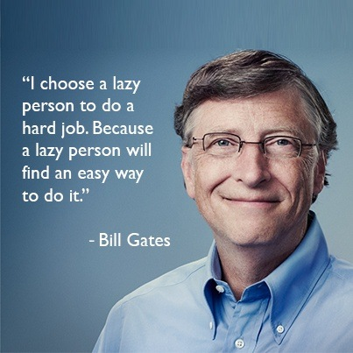

Slide 42
Performance
WCF adds some overhead
SOAP is slower than RESTful
Stored procedures a little faster than entity
The more security you add, the slower the service will be.

Slide 43
Usability
Don’t make the service unusable
Find balance

Slide 44
Service Programming
Example code: https://github.com/raithedavion/AppSecUSA2017

Slide 45
Contact Info
Twitter: https://twitter.com/raithedavion (@raithedavion)
Email: Kelly.correll@nemtechcs.com or Kelly.Correll@NTTSecurity.com

Slide 46
nttsecurity.com
Thank You
© 2017 NTT Security

